Slide 1
Web Scraping And Word Frequency analysis with python
Presented by
GEET GOVIND

Slide 2
Introduction
Web Data Retrieval - Web scraping involves extracting data from websites using automated methods. Here we extract data from “www.python.org”.
Requests Library - The requests library in Python allows for making HTTP requests to retrieve web pages.
Beautiful Soup - Beautiful Soup is a Python library for parsing HTML and XML documents.
URL Retrieval - Identify the target website and retrieve its URL.
HTTP Request - Use the requests library to send an HTTP request to the URL and retrieve the HTML content.
Data Parsing - Utilize Beautiful Soup to parse and extract the desired data from the HTML content.

Slide 3
Object
Target Website - Retrieve the URL of the target website, 'python.org'.
HTTP Request - Use the requests library to send an HTTP GET request to the website.
Data Extraction – Study the HTML and CSS program of website and find out the class and widgets through which required data can be extracted.
Response Handling - Receive and handle the response from the website.
Word Frequency Analysis - Count the frequency of each word in the extracted text data.

Slide 4
Tools and library used
Following Libraries are used to work with this project :-
Beautiful Soup
Requests
Selenium
Time

Slide 5
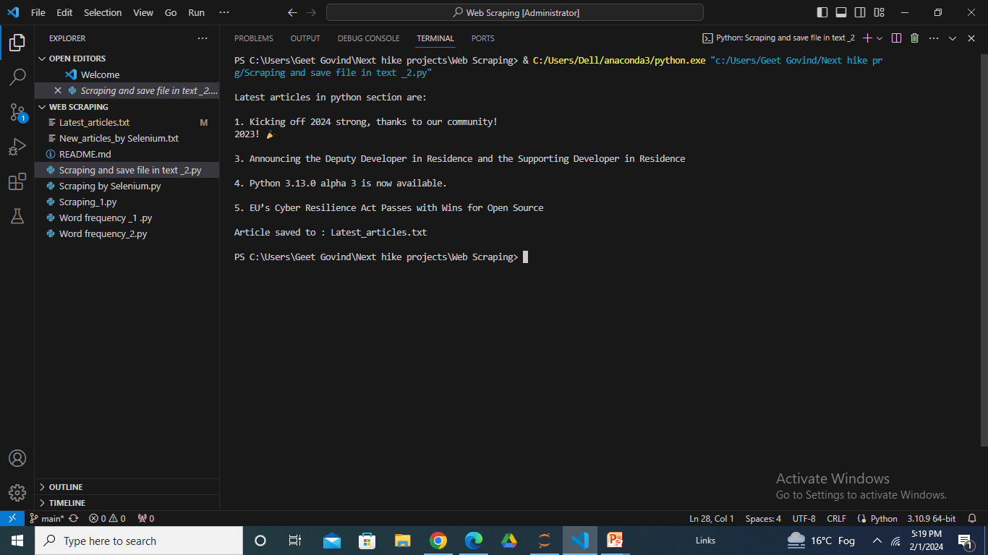
Web scraping
Web scraping is done here from www.python.org
with the help of Beautiful Soup and Request libraries.
This result came from (Scraping and save file in text _2.py)
The output got from code is attached here.

Slide 6
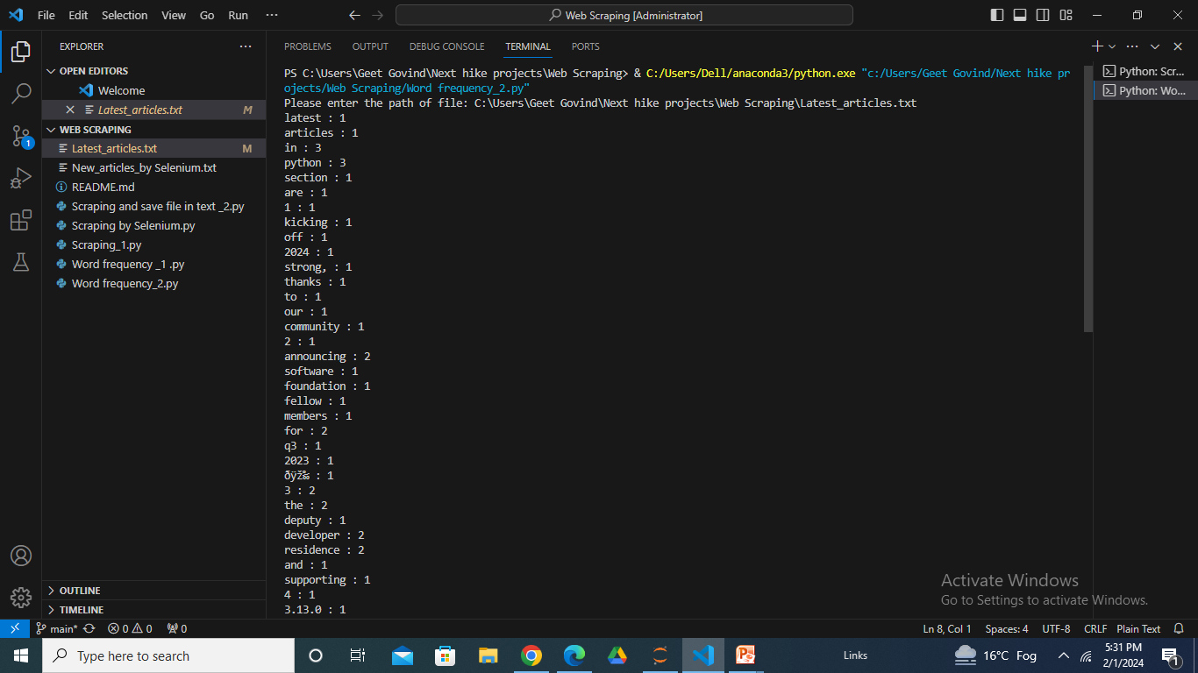
Word frequency count
The frequency of words is count from the Latest_articles.txt which was saved in text file through web scraping.
The program is giving text count of each word and the output is attached here:

Slide 7
Result
The data is scrapped from website www.python.org, I have done it from different-different 3 ways, code of which is attached in Github account inside repository.
The word frequency count is also done in two ways, both of them are giving proper counting of occurrence of words.
The output came from program is attached in previous slides.

Slide 8
conclusion
There are total 5 latest articles available on website and I scrapped them. Saved them in a text file parallel by coding.
Final text file is saved by the name of Latest_articles.txt.
The word frequency count of all the words is extracted from text file and we can check occurrence of any work we want with the help of attached coding program.

